Slide 1
Airway management in COVID-19 PATIENTS Dr Vipin Kumar Singh Associate professor Deptt of Anesthesiology, KGMU

Slide 2
Categories of patients with COVID-19 infection requiring admission to a hospital
Self-sufficient patients,
no additional oxygen administration required,
no organ failure:
Return home
Medical checkup 24–48 hours, depending on the condition

Slide 3
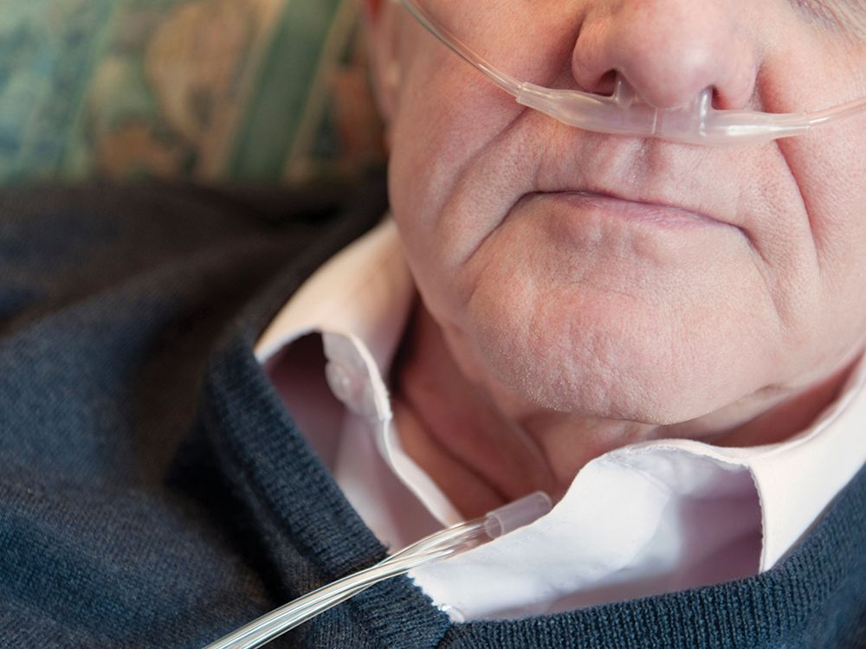
Patients requiring hospital care or oxygen administration,
Hospitalisation on a ward, if possible defined as COVID-19 ward with usual supervision
Oxygen administration via nasal cannula/probe, maximum 4 l/min, with intermittent monitoring of oxygen saturation and breathing frequency 3-4 times per day

Slide 4
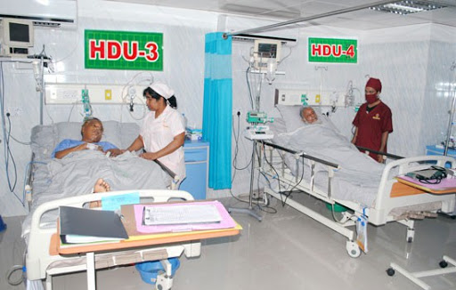
Patients who require oxygen therapy and continuous monitoring of vital parameters (at least SpO₂, ideally blood pressure, heart rate and respiratory rate):
Hospitalisation in an intermediate care (IMCU) or high dependency unit (HDU)
Oxygen administration via nasal cannula/probe, Venturi mask or reservoir mask (max. 15 l/min, no nasal high-flow device)

Slide 5
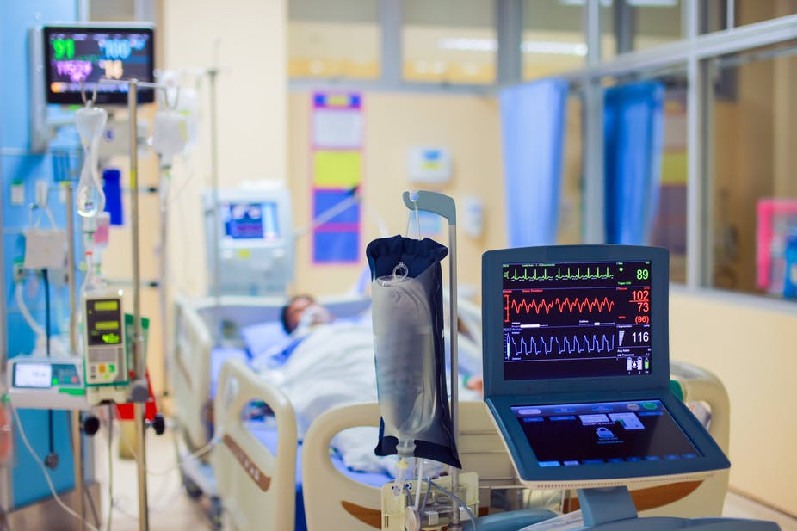
Patients with increasing organ dysfunction (e.g., increasing respiratory failure)
Transfer to the intensive care unit (ICU)

Slide 6
Recommendation in hypoxiC COVID-19 patients

Slide 7
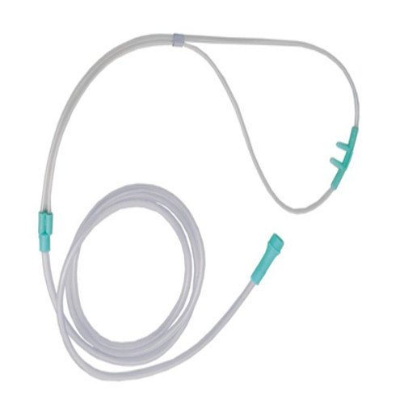
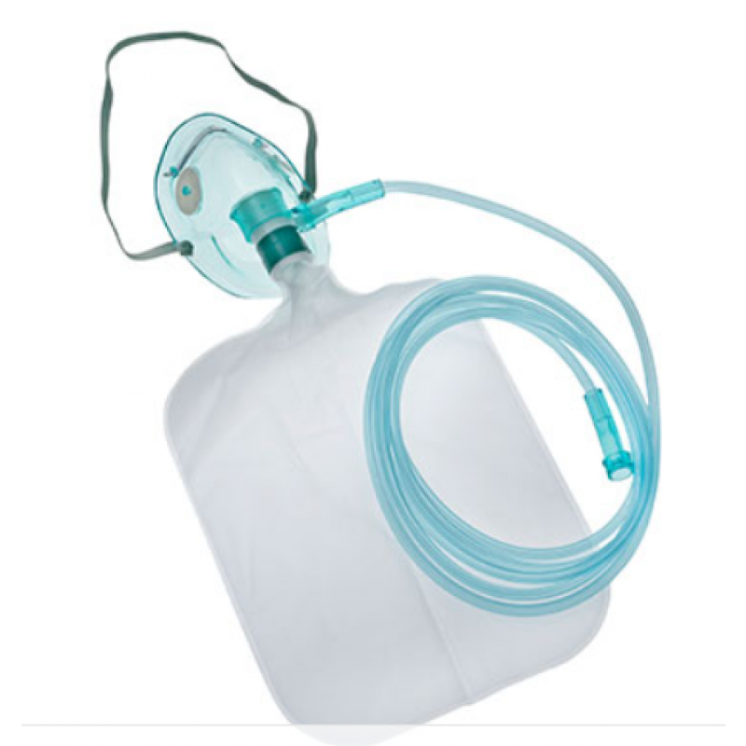
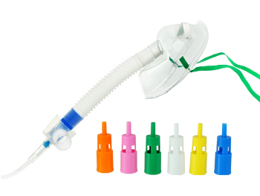
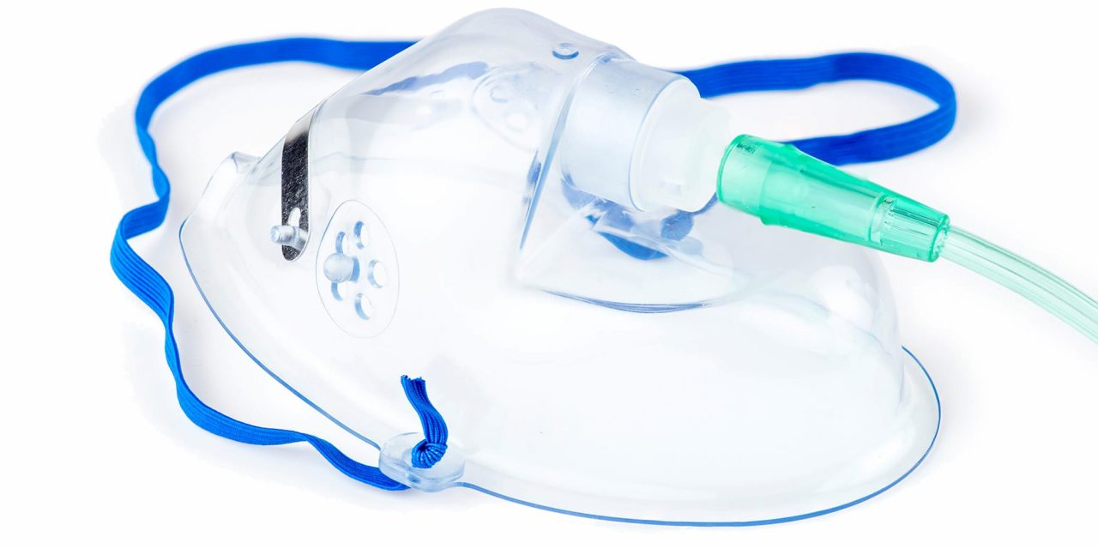
oxygen therapy DEVICES
Nasal cannula
Hudson mask
Non- rebreather mask
Ventury mask

Slide 8
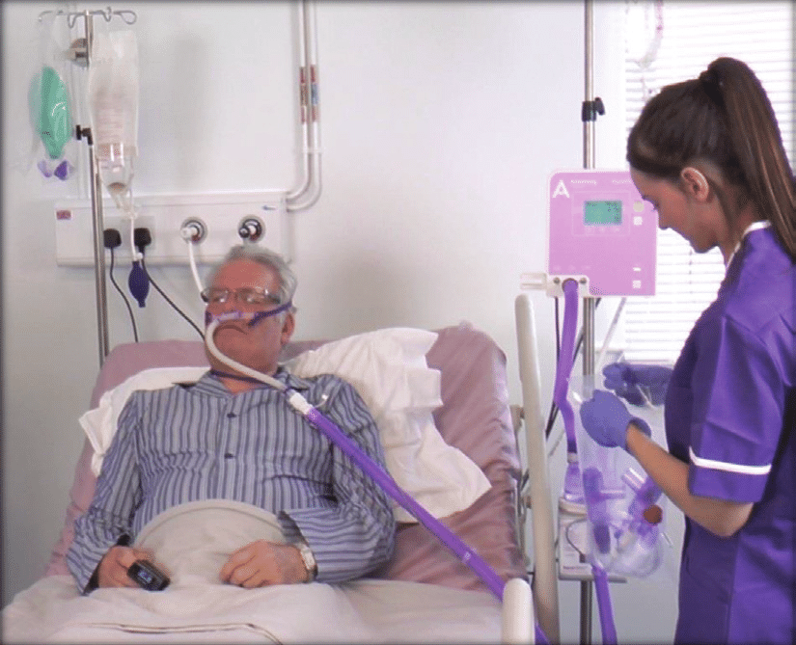
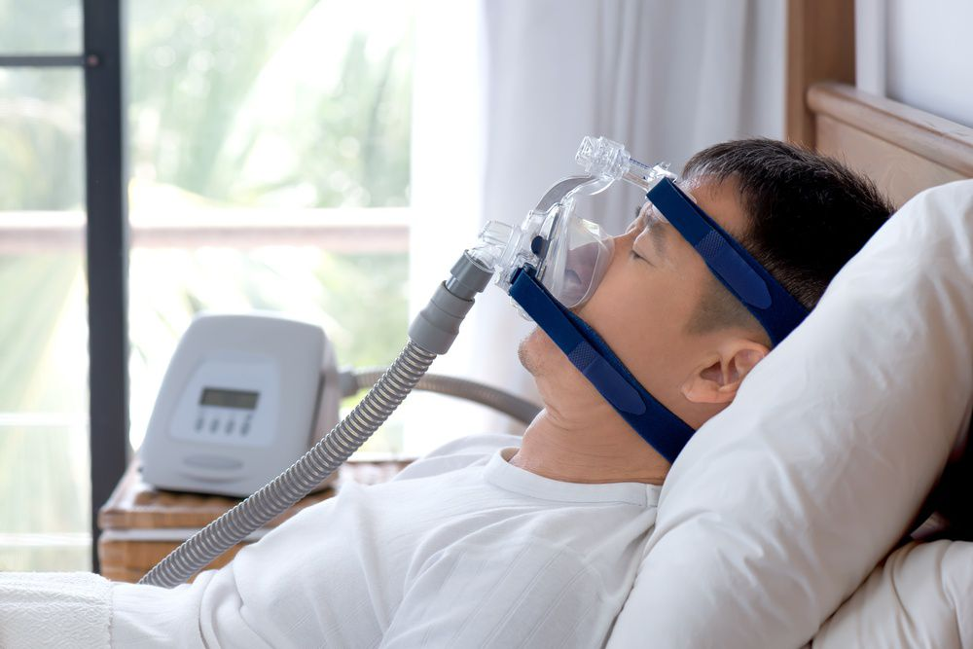
HFNC
NIV
* HFNC and NIV may be considered but with extra precautions

Slide 9
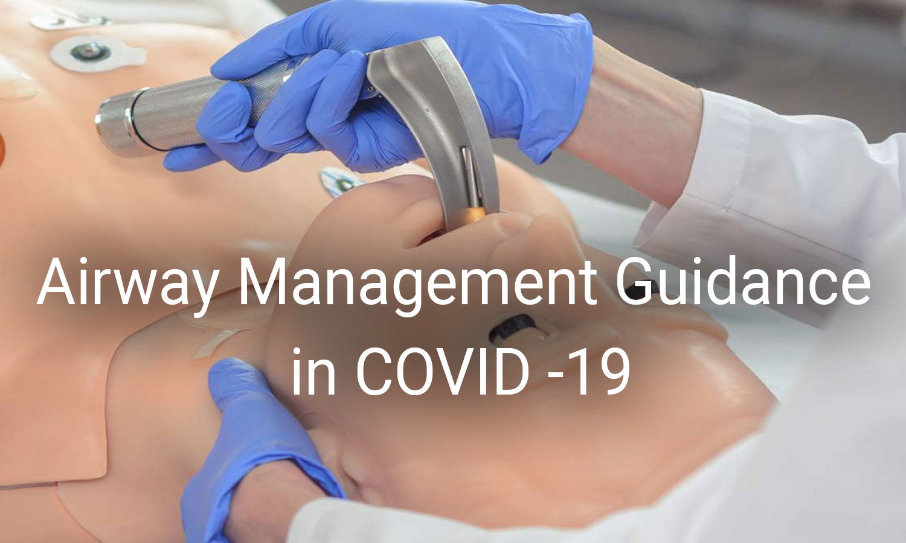

Slide 10
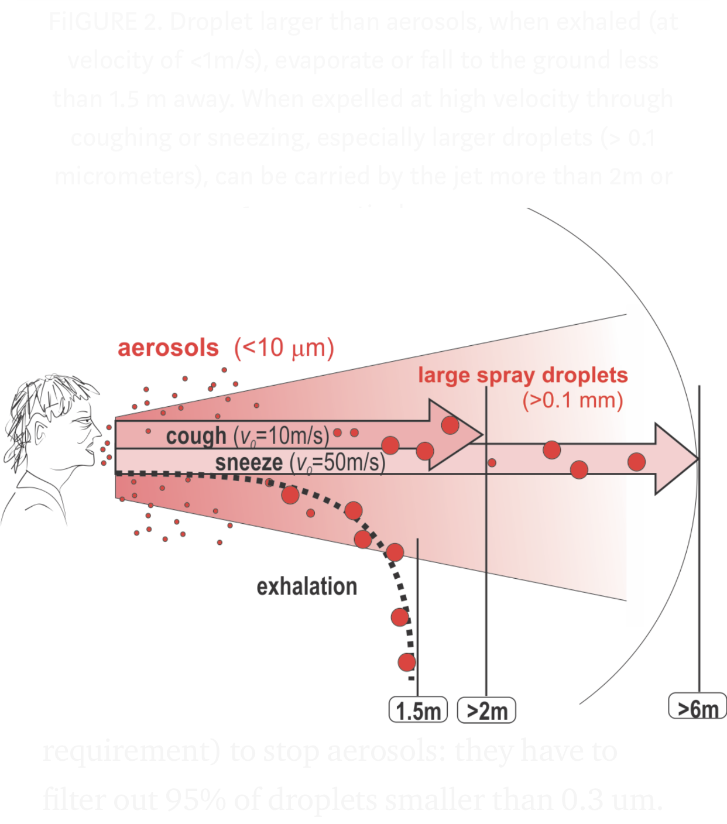

Slide 11
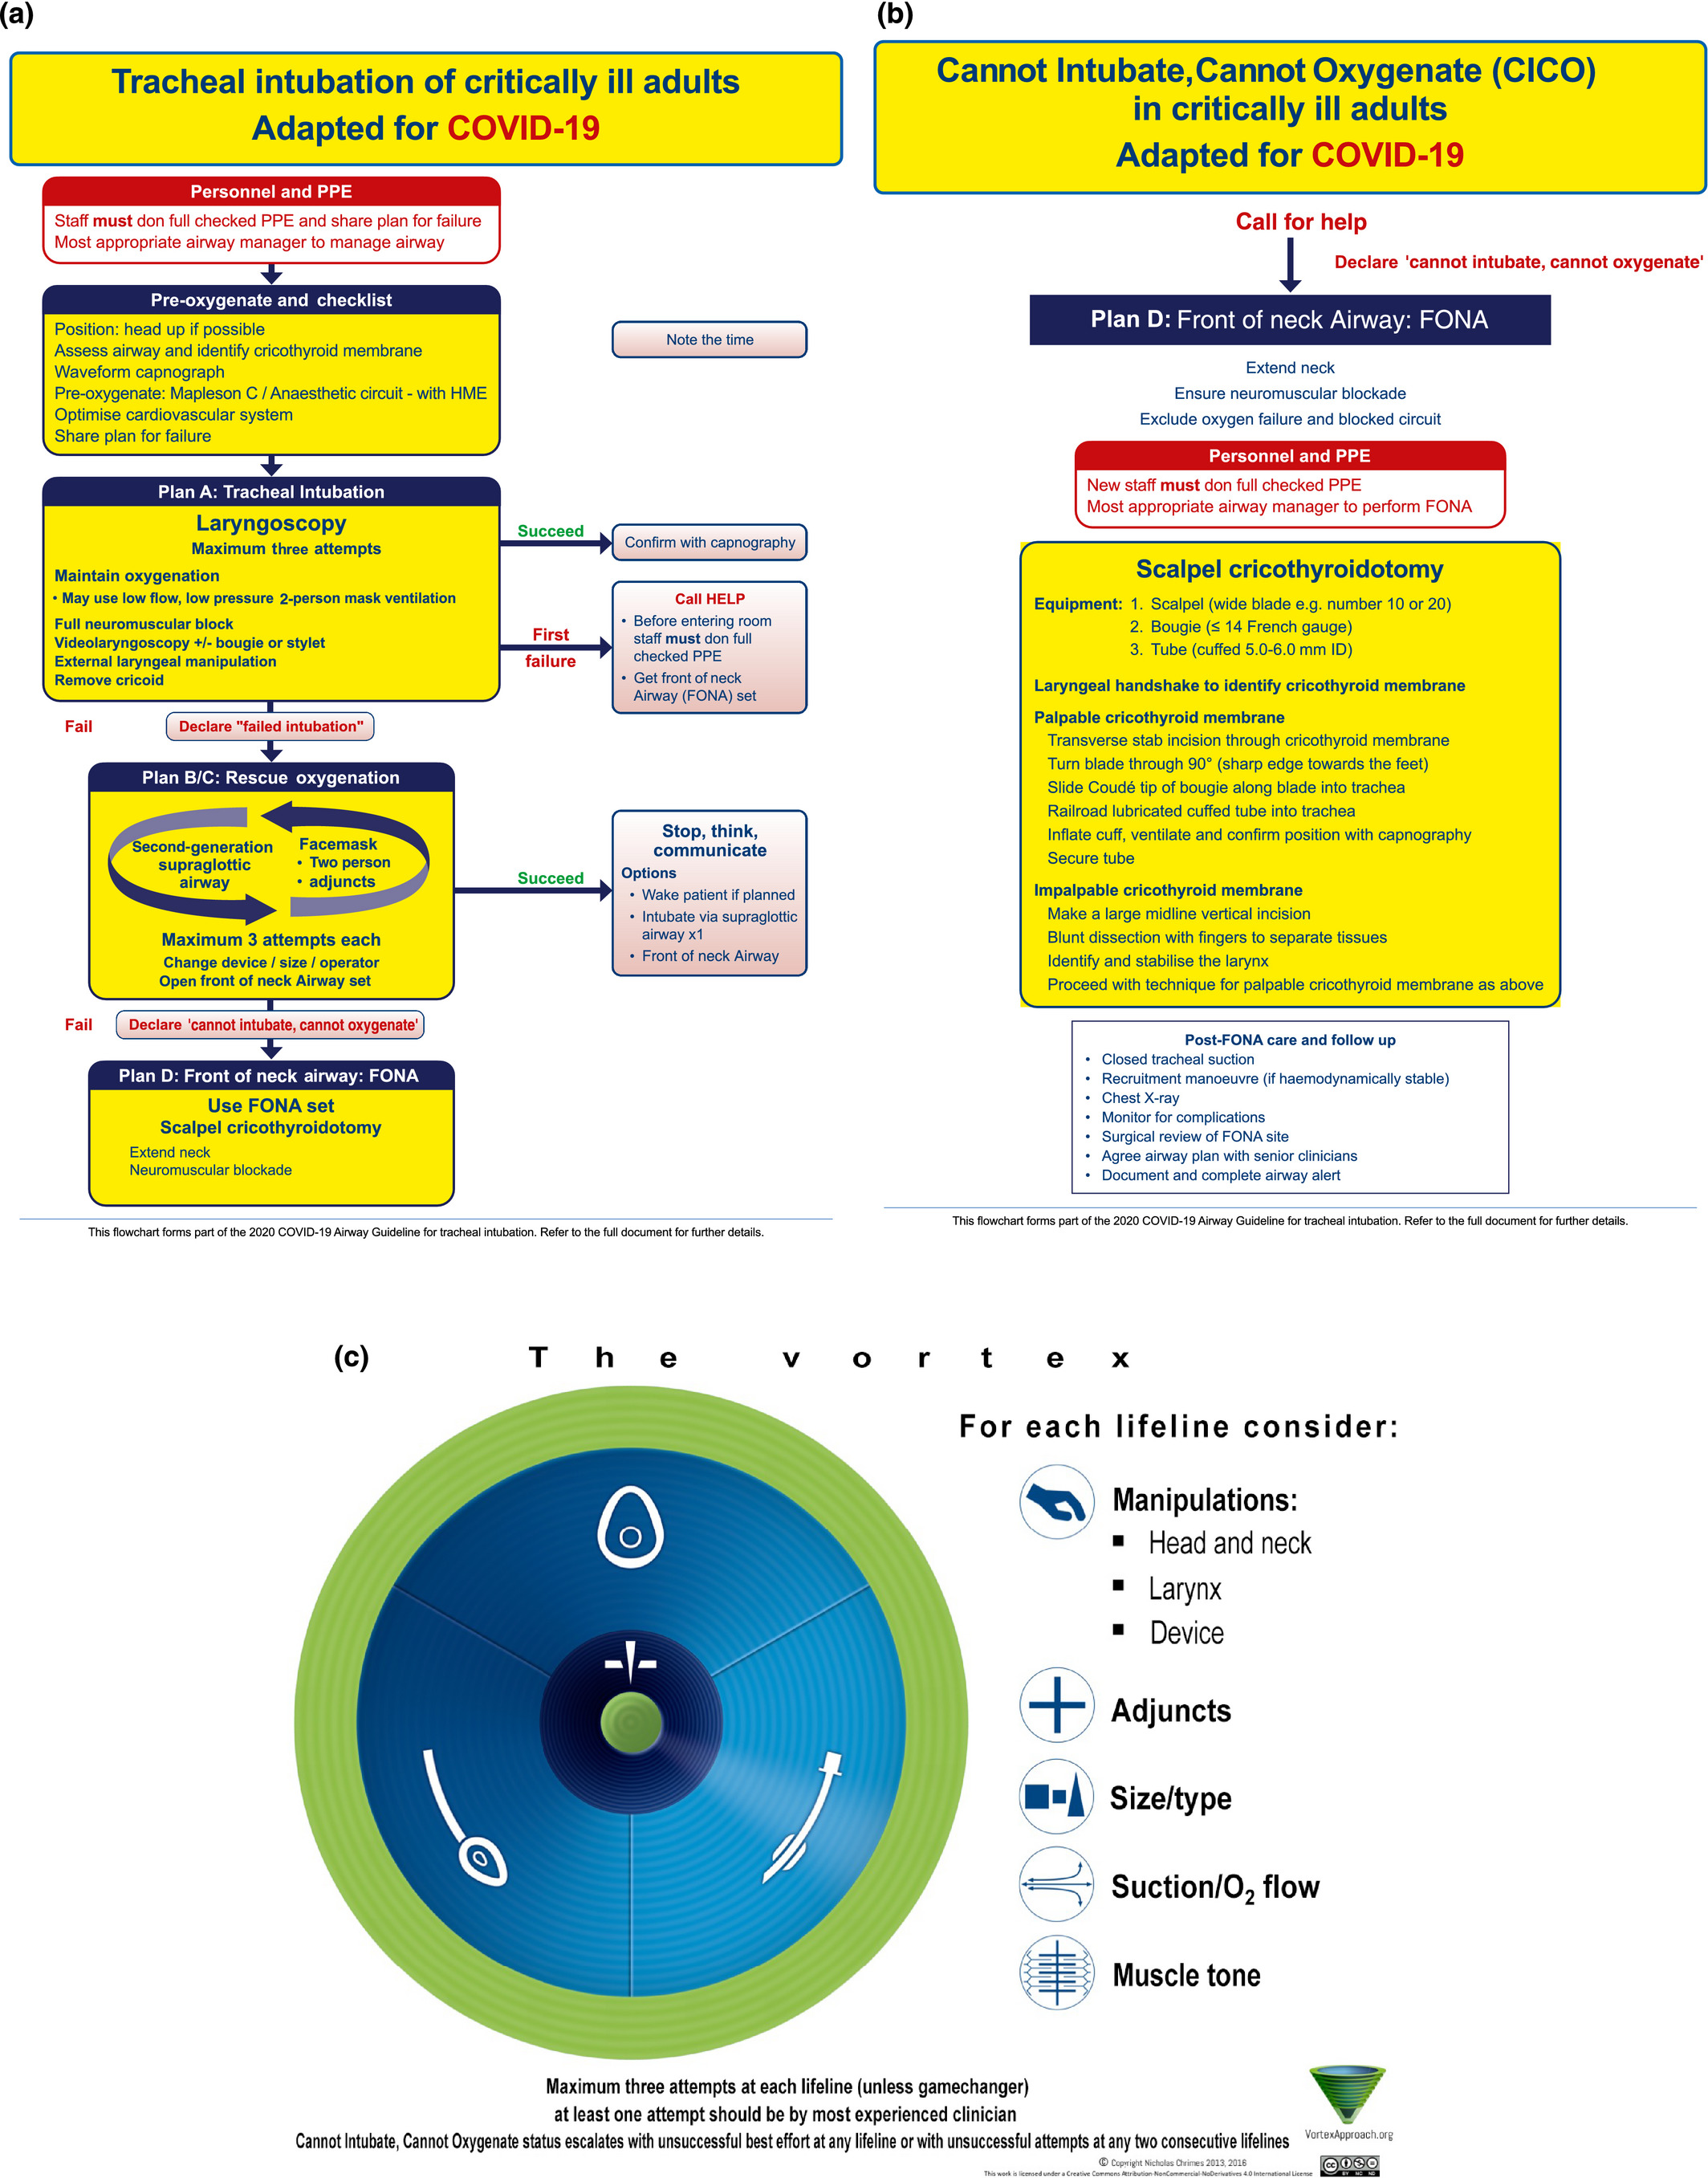

Slide 12
Crucial steps

Slide 13
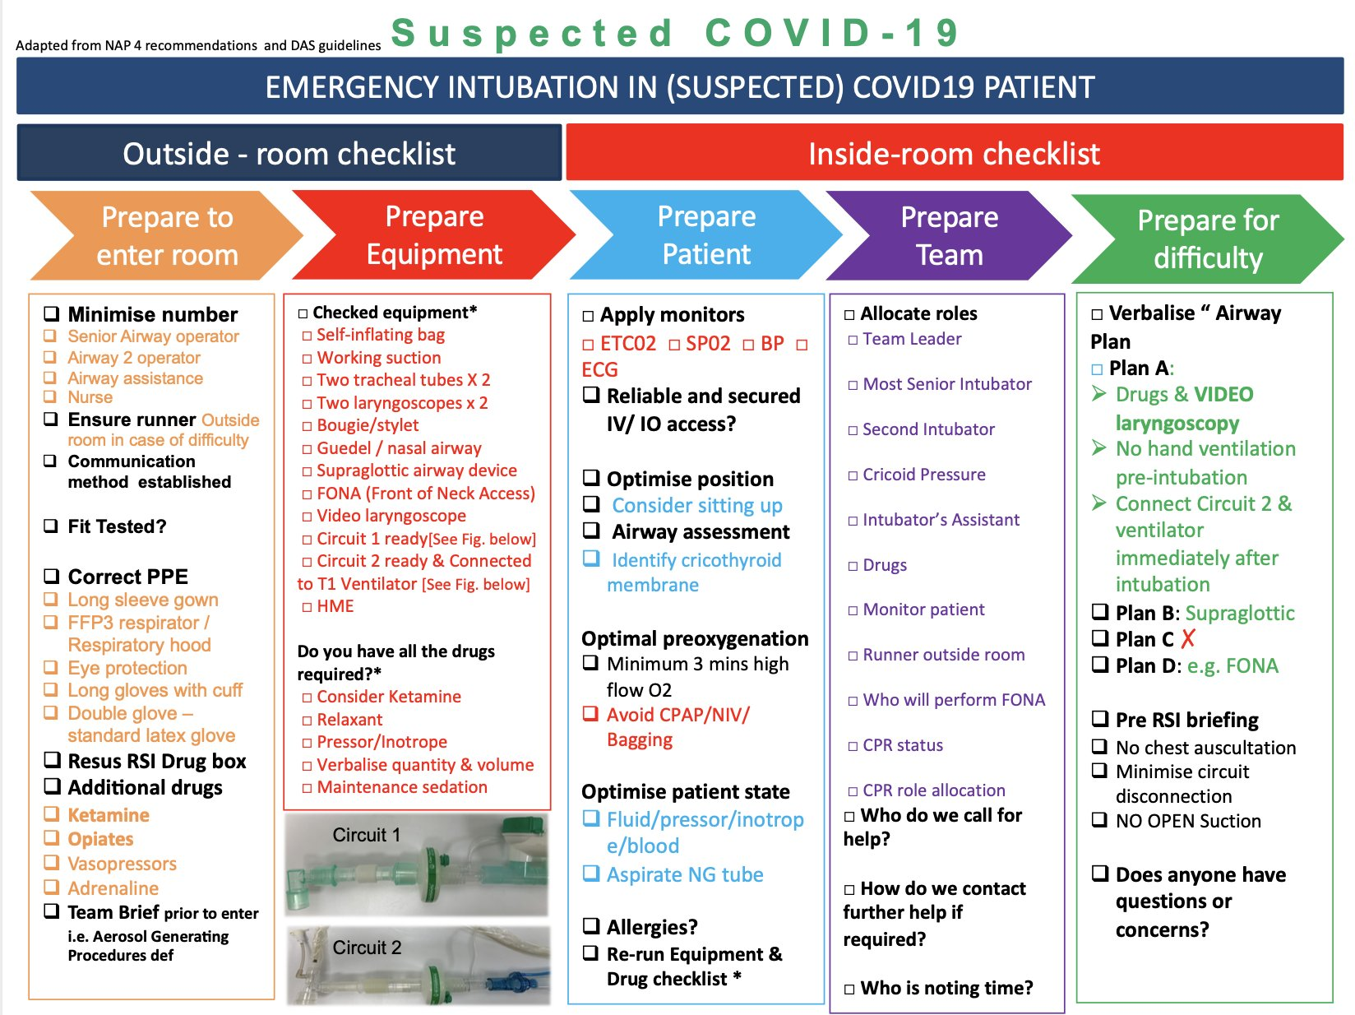
1. preparing checklist

Slide 14
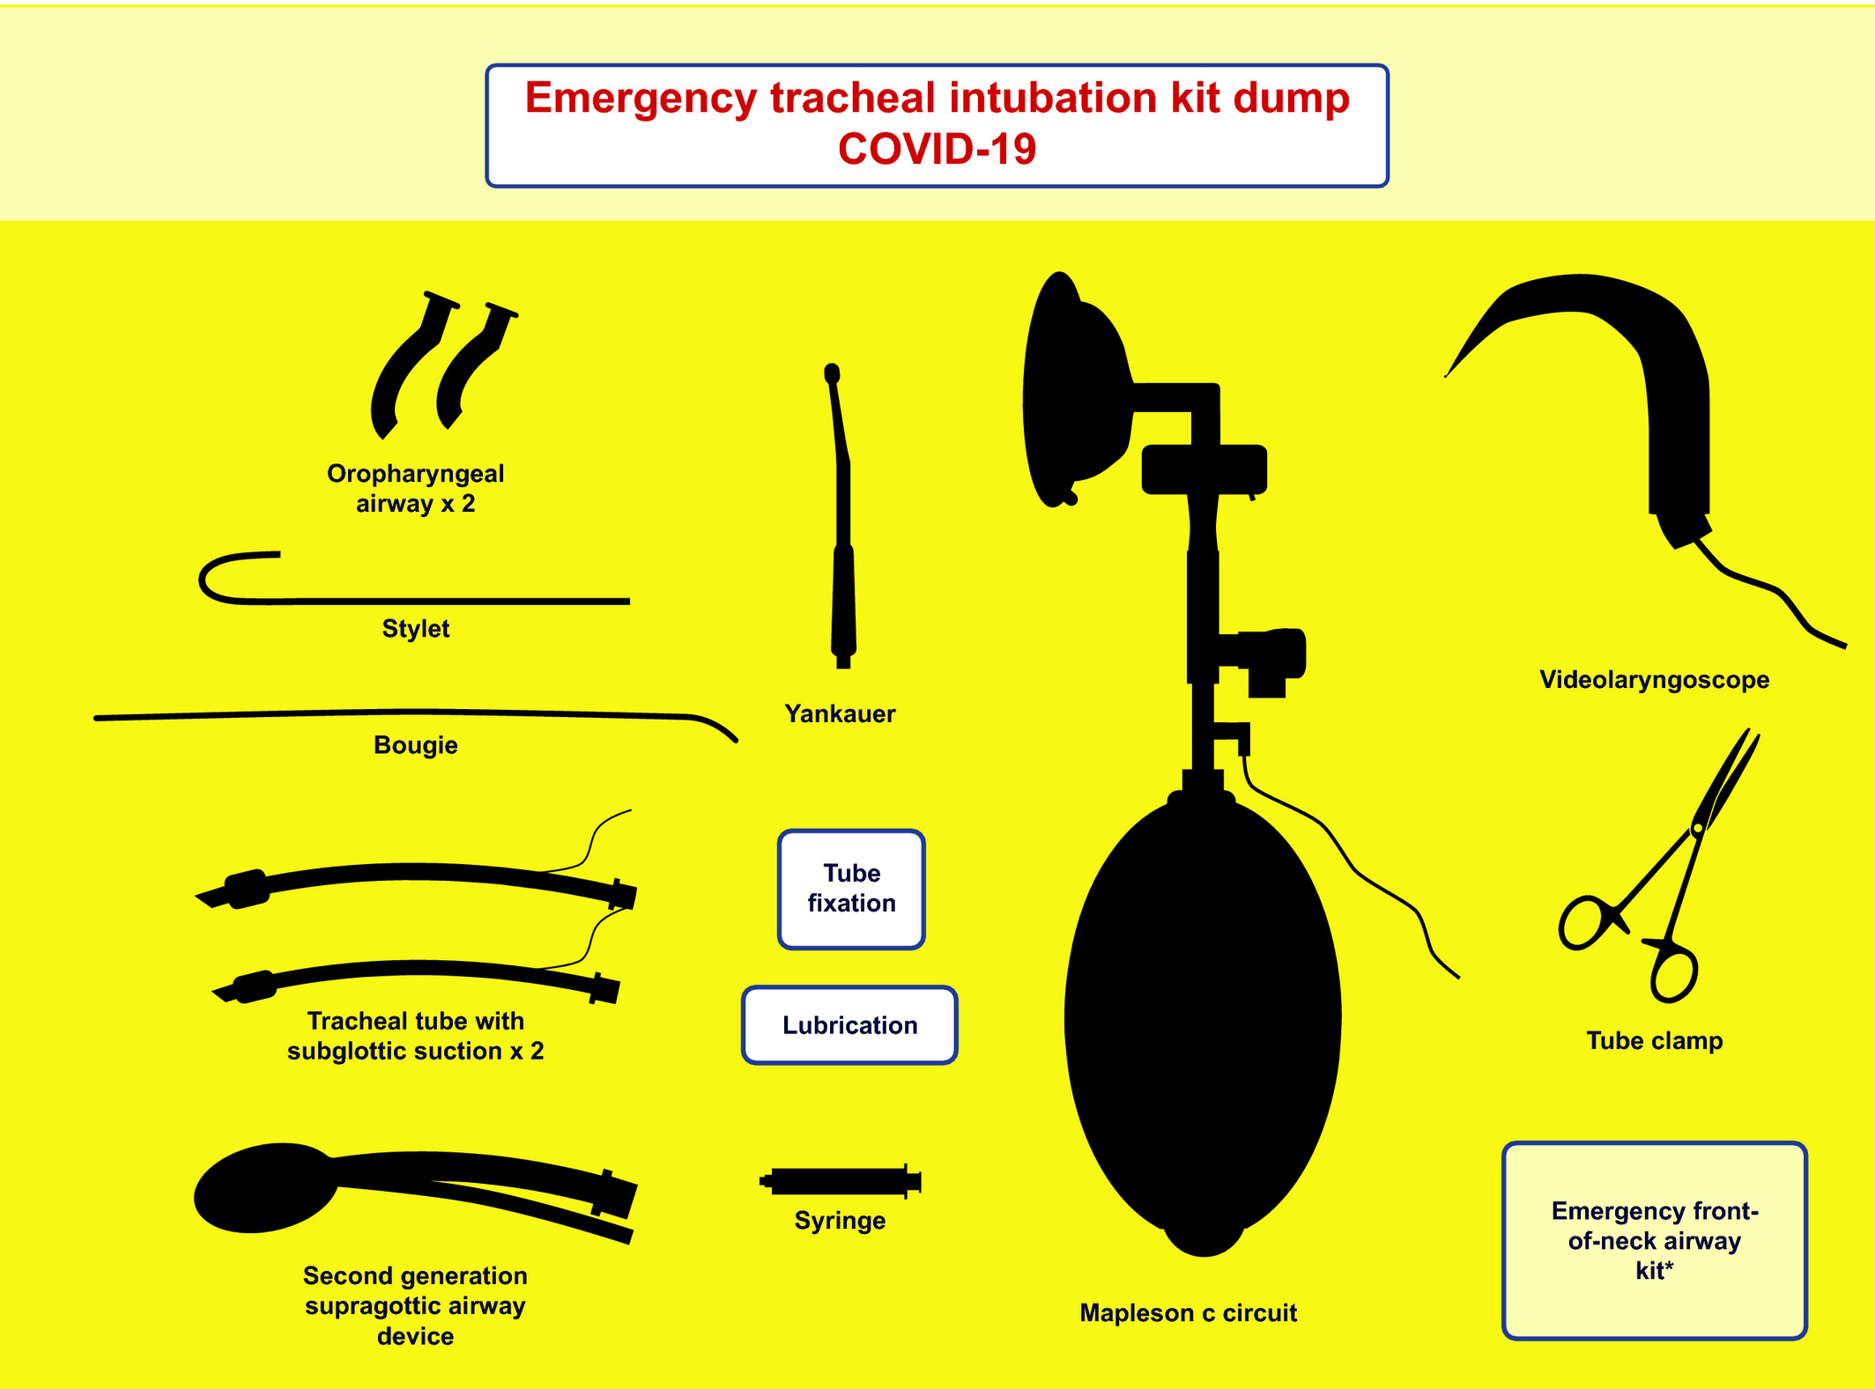

Slide 15
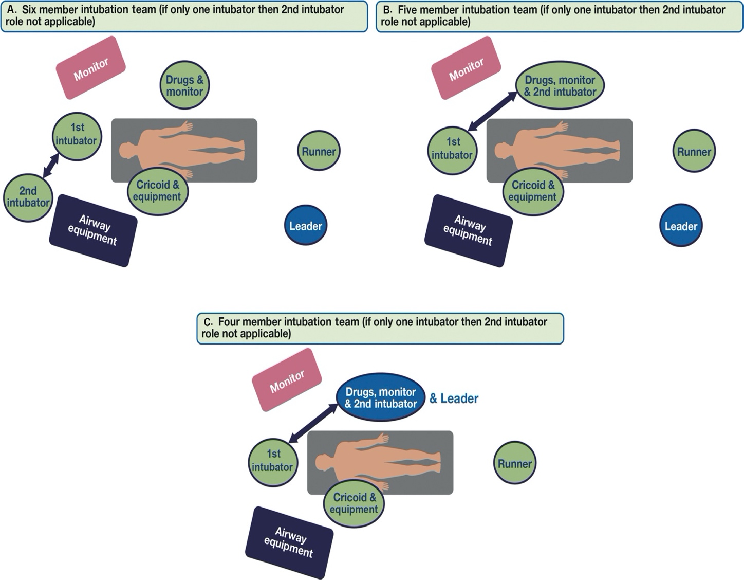
2. Managing team

Slide 16
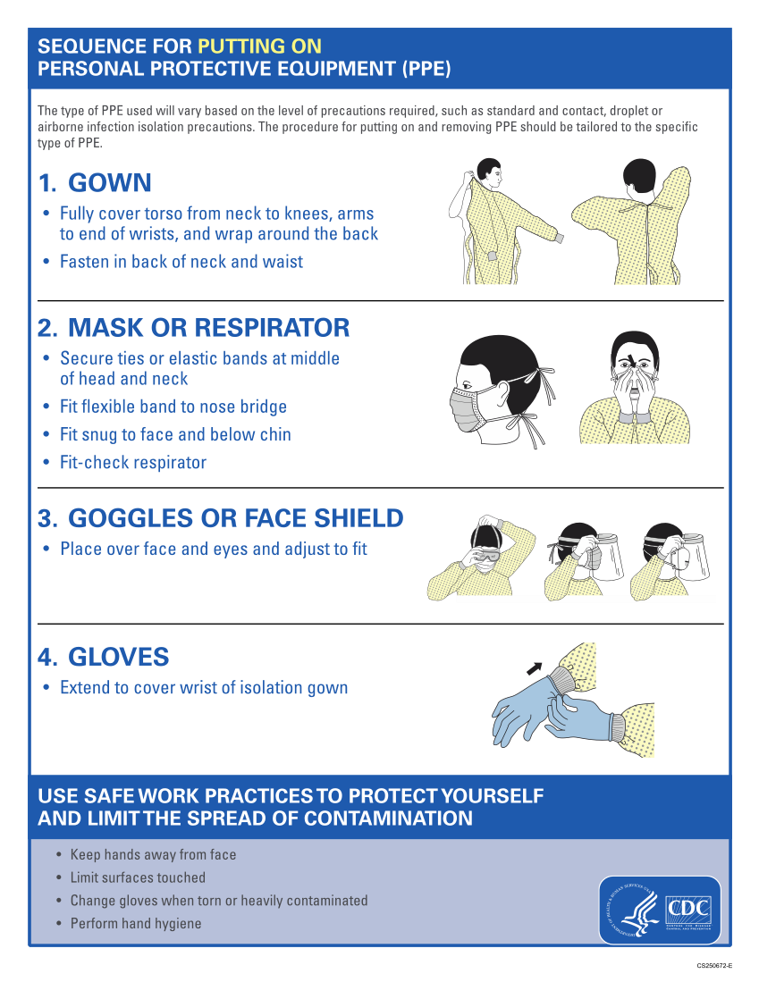
3.donning PPE

Slide 17
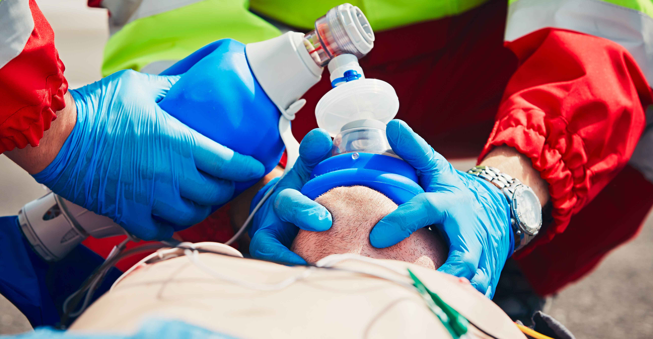
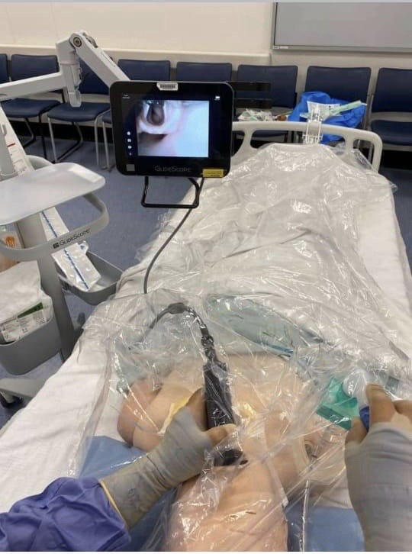
4. Mask ventilation and laryngoscopy
Positive pressure ventilation not recommended
Apply HEPA filter
*Video laryngoscope first choice

Slide 18
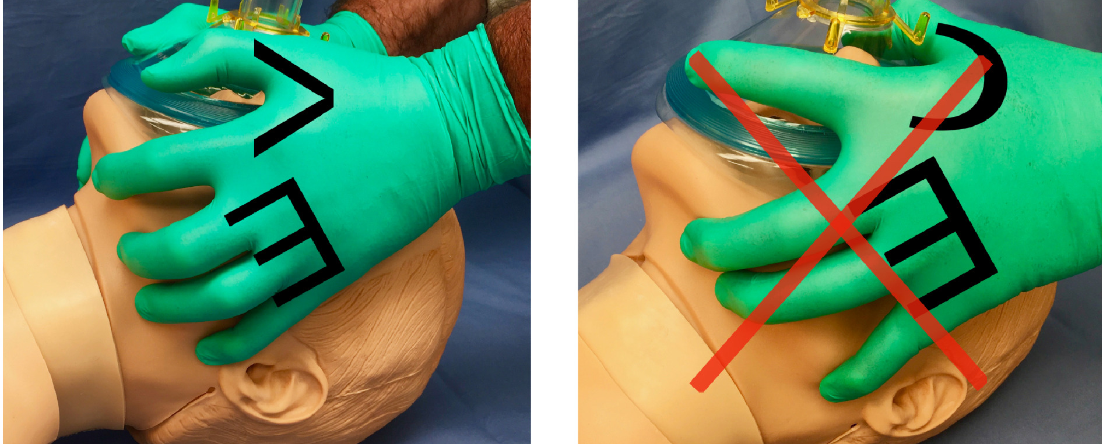

Slide 19
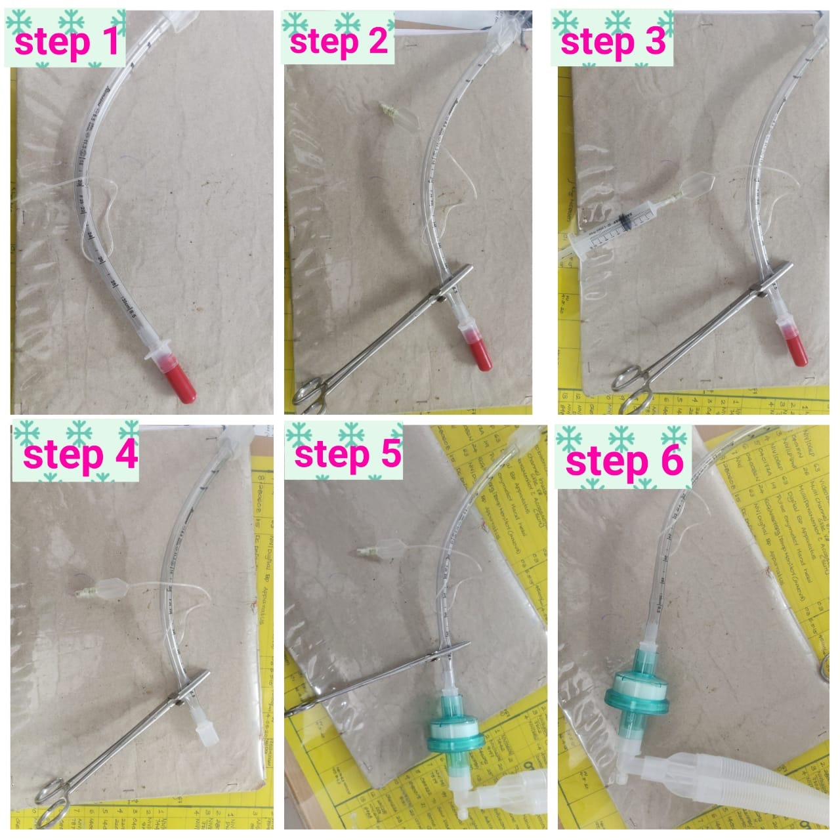
5. Circuit disconnection and reconnection
* To avoid aerosol generation

Slide 20
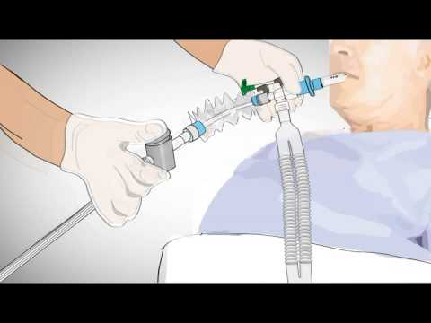
6. ET SUCTIONING
* Closed suction technique

Slide 21
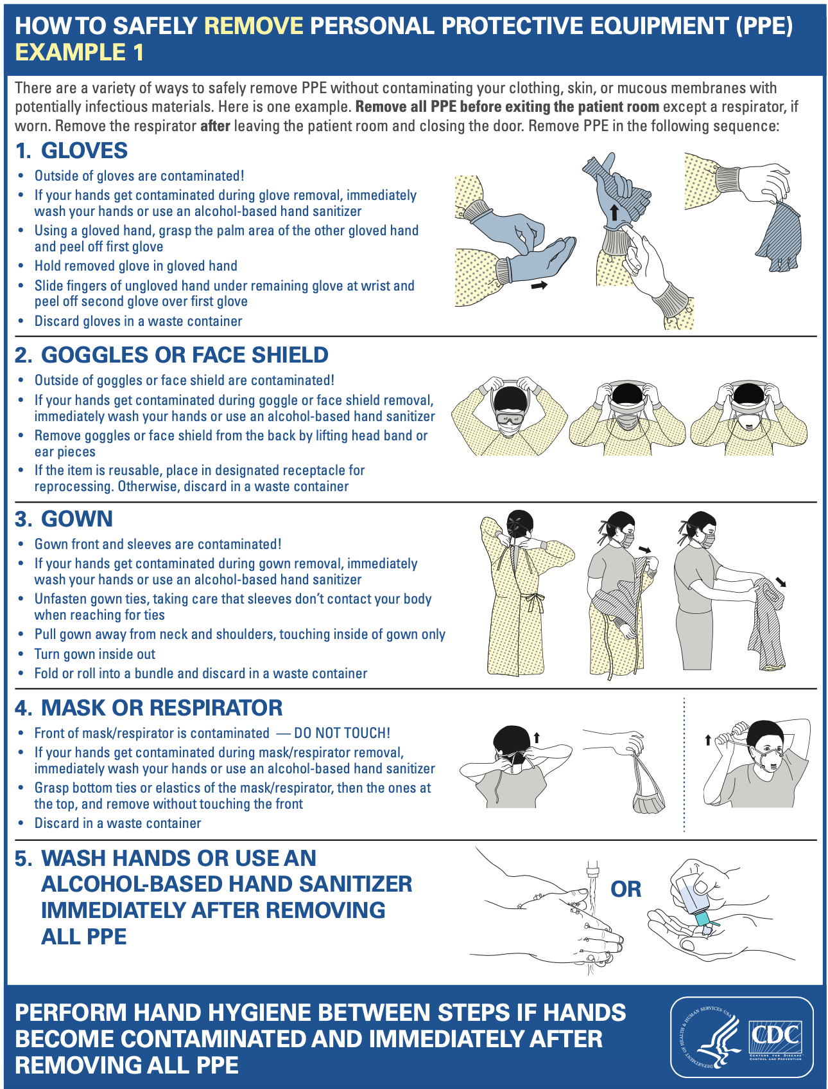
7. doffing of PPE

Slide 22
thank you

